Slide 1




UHACK 3.0
TITLE PAGE
Problem Statement ID: 7501
Problem Statement Title: Student Innovation
Theme: Student Innovation
PS Category: Software
Team ID: UHK03251
Team Name: Cogni–Z.I.D.S.

Slide 2

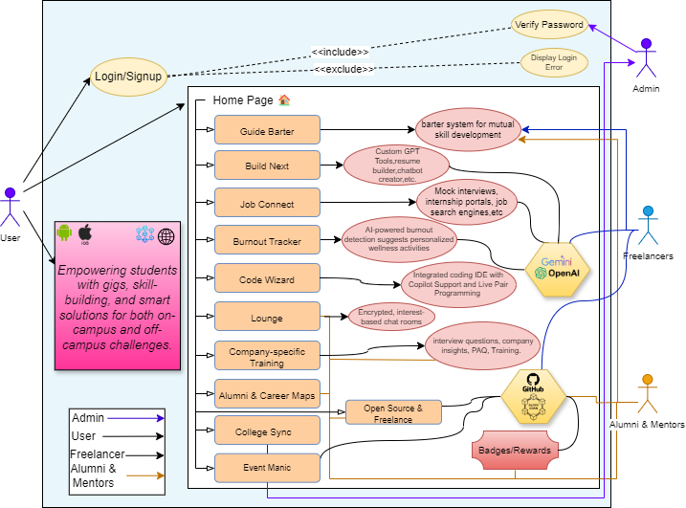






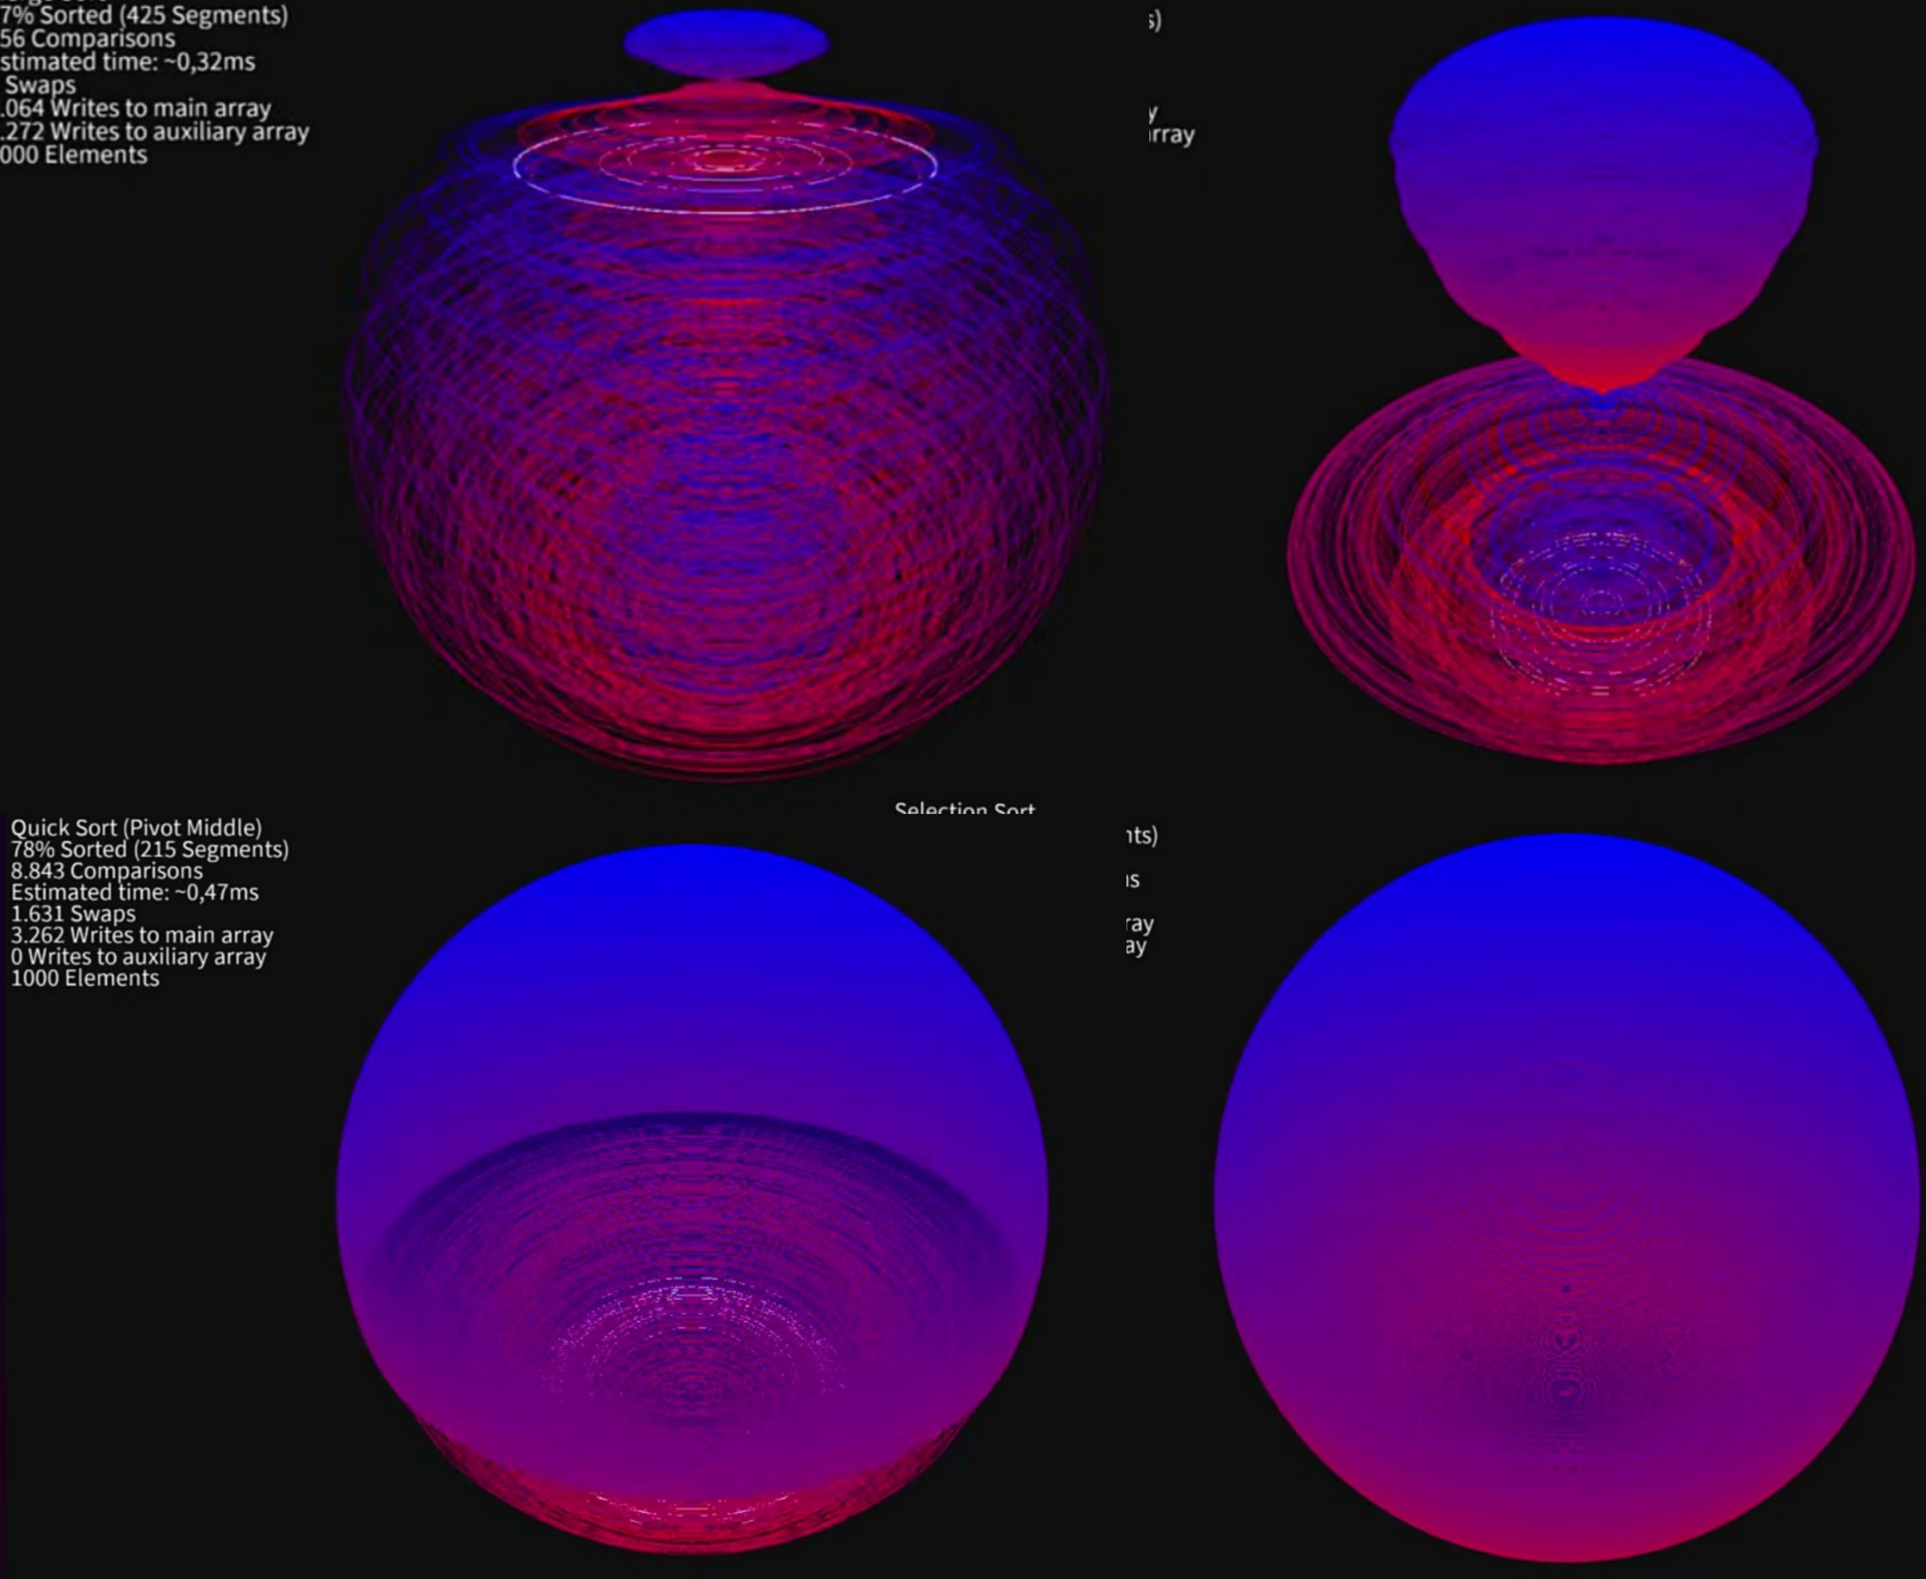





IDEA TITLE
Proposed Solution: Codify: Empowering tomorrow's professionals, today.
Codify provides a unified and all-in-one platform to guide students and professionals by offering essential academic and professional tools. It helps you move seamlessly from college to career with resources, connections, and innovative features.
USE CASE DIAGRAM:
1. Guide Barter: A decentralized, peer-to-peer platform using smart contracts for skill exchange and guided mentorship.
2. Build Next: AI-driven NLP tools for resume generation, chatbot creation, and custom GPT model.
3. Lounge: Encrypted, interest-based chat rooms powered by decentralized communication protocols.
4. Job Connect: AI-powered job-matching algorithms with automated application submissions and startup-friendly portals.
5. Inter(company's)view: Machine learning-based mock interviews with company-specific datasets and real-time feedback.
6. College Sync: Cloud-based access to semester-wise PYQs, notes, and video tutorials with seamless synchronization.
7. Alumni & Career Maps: Blockchain-verified alumni networks and AI-generated career road maps.
8. Event Manic: Blockchain-based credential verification for events and seminars, ensuring tamper-proof certificates.
9. Code Wizard: Integrated coding IDE and competitive coding platforms
10. Open Source & Freelance: GitHub API integration for tracking open-source contributions and freelance work, earning blockchain-verified skill badges.
AR 3D MODELING OF SORTING TECHNIQUE
Our Stand Out Feature:
AR Learning Hub: Codify offers immersive 3D models and simulations for subjects like engineering, architecture, etc making complex topics engaging and interactive.

Slide 3
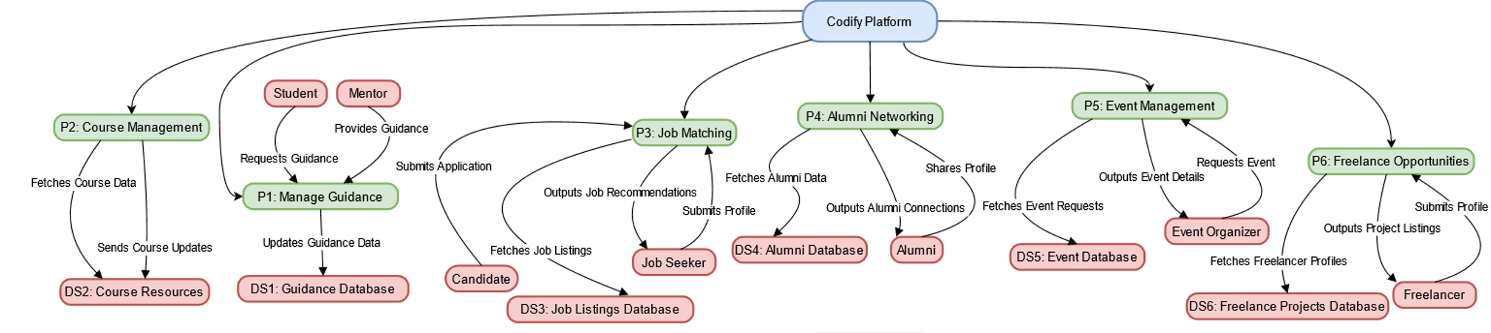
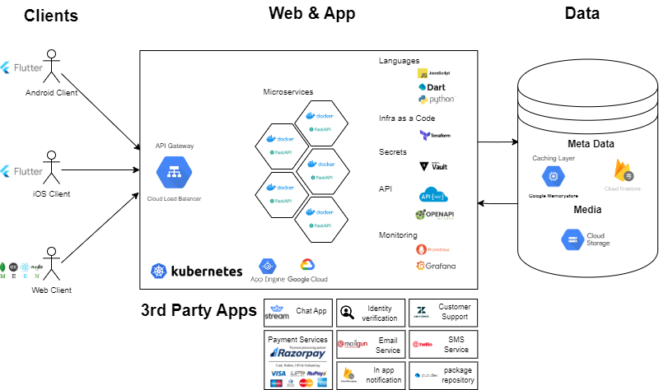
TECHNICAL APPROACH
DATA FLOW DIAGRAM:
TECH STACK:
Tech Stack & Dependencies:
MERN Stack (MongoDB, Express, React, Node.js) with Next.js for server-side rendering.
Flutter & Dart with BLoC for state management and Firebase for real-time data, authentication, and hosting.
Socket.io for real-time communication.
Blockchain for secure transactions.
Flutter packages: HTTP, Provider, Firebase Core.
AR Technologies: ARKit 4 (iOS), ARCore (Android), Unity Engine, Vuforia, Spark AR for filters, and Luma API for advanced AR.
Version Control: Git and GitHub.
REST APIs for data exchange.
Libraries/Dependencies:
Axios or Fetch for API requests.
Redux or Context API for React state management.
Web3.js for blockchain integration.
Lodash for utility functions.
Core Tech Stack:
GITHUB REPO: dubeysanskar/codify (github.com)​

Slide 4
FEASIBILITY AND VIABILITY
USE CASES/ FEASIBILITY:
Proven Technologies: Leverages React for responsive front-end development, AI-driven Natural Language Processing (NLP) for automation (resume building, chatbot creation, etc.), and Blockchain for decentralized verification (certifications, alumni networks).
Cloud Scalability: Uses cloud-based architecture to ensure high performance, reliability, and real-time synchronization of resources, from study materials to interview simulations.
Smart Contracts & AI Integration: Seamlessly integrates smart contracts for secure peer-to-peer skill bartering and AI algorithms for real-time job matching and personalized feedback.
SHOWSTOPPER/ CHALLENGES:
Resource Management: Scaling resource libraries (notes, past year question papers, projects) across multiple educational institutions.
Sustained User Engagement: Ensuring users remain engaged across multiple offerings like skill exchanges, mentorship, and job opportunities.
SOLUTIONS:
AI-Powered User Retention: Implement personalized AI-driven notifications and learning pathways based on user behavior and interests.
Decentralized Incentives: Introduce blockchain-verified rewards and badges for open-source contributions, skill acquisition, and freelance work to foster long-term engagement.
Cross-Platform Accessibility: Ensure seamless access across devices (web and mobile), making resources and opportunities available anytime, anywhere.
VIDEO SOLUTION LINK: https://drive.google.com/drive/folders/147sRlDFJCbQoLVsn7LRGaPF9VxaN7Kz0

Slide 5
IMPACT AND BENEFITS
IMPACT:
Impact on Target Audience:
For Students & Professionals: Access to industry-specific resources, AI-powered job matching, and skill development—all under one platform.
For Freelancers: Build a recognized portfolio with verifiable contributions to open-source projects, making your work easily visible to recruiters.
For Universities & Companies: Seamless integration of career pathways with verified alumni networks and decentralized mentorship programs.
Broad Impact:
Social Impact: Fosters collaboration and continuous learning through decentralized peer-to-peer exchanges and mentorship.
Economic Impact: Bridges the skills gap by connecting fresh graduates and professionals with internships and job opportunities.
Career Impact: Provides personalized career paths and real-time feedback, enhancing job readiness and long-term professional growth.
BENEFITS:
Efficiency: Simplifies the journey from learning to employment using AI, Blockchain, and cloud infrastructure, minimizing barriers in job searching and skill verification.
Trust & Security: Blockchain ensures tamper-proof credentials, enhancing trust for recruiters and mentors.
Scalability: Cloud architecture supports large-scale resources and real-time synchronization.
User Retention: AI-driven incentives like personalized learning paths and skill badges keep users engaged long-term.
REVENUE STREAMS:
Subscriptions: Charge for premium features like advanced tools, AI-driven services, and mock interviews.
Freemium: Offer basic features free, with paid upgrades (e.g., custom GPT models, verified certifications).
Corporate Partnerships: Companies pay for recruitment access to verified candidates.
Rental Collaborations Model: Charge institutions for resource management and student career services.
Freelance Commissions: Take a cut from freelance transactions on the platform.

Slide 6
RESEARCH AND REFERENCES
AI-Powered Mental Health Interventions for Young Adults:
​https://ai.jmir.org/2022/1/e38171
Artificial Intelligence for Career Guidance– Current Requirements and Prospects for the Future:
https://files.eric.ed.gov/fulltext/EJ1318705.pdf
https://www.researchgate.net/publication/354171816_Artificial_Intelligence_for_Career_Guidance_-_Current_Requirements_and_Prospects_for_the_Future
Gamification in Education: What, How, Why Bother? by Educause Review:
https://www.researchgate.net/publication/258697764_Gamification_in_Education_What_How_Why_Bother
Peer Review and Feedback with AI: Enhancing Student Learning by MIT News:
https://news.mit.edu/2016/using-educational-technology-enhance-student-learning-0805
Gig Economy in Education: Opportunities and Challenges by World Economic Forum :
https://www.weforum.org/agenda/2021/05/what-gig-economy-workers/

